Slide 1
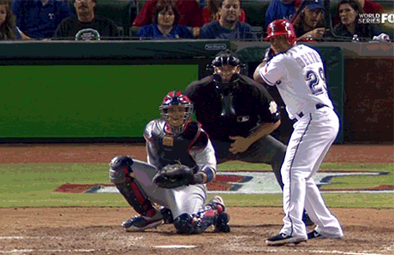
Superstar players based on their salaries
Project 1: Calvin Cusick,
Ebrahim Moosa, Nicklaus Austin, Diana Andrade

Slide 2
Overview
Overview Data Set
Inspiration
Research questions
Our Analysis
Our Conclusions

Slide 3

Data Overview
Our data resources came from Kaggle which we gathered different CSV file paths to determine different questions that we can possibly come to conclusions to our questions.
Focused on data from 2000 to 2016
Finalized csv paths that contained sufficient data to determine our hypothesis
Cleaned data set and analyze outliners

Slide 4
Inspiration
Looking into a sport profession and analyzing data from superstar players to understand how their salary is based upon their stats/ athletic ethic etc.
The below article is data from all mlb superstar players as of 2017 where we can create conclusions on particular interest to base our own conclusions through out a period of years.
MLB Superstar Power Rankings: How Each Team's Biggest Star Stacks Up | Bleacher Report | Latest News, Videos and Highlights

Slide 5
Research questions
Does winning % increase with team player value (sum of players value)?
How much do “superstar” players affect team play? If they are out of action, does win % go down?
What effect does team salary have on team wins?

Slide 6
Hypothesis
If a franchise spends more money on their team, than win rate increases.
If a team has a superstar player , then team win rate increases.

Slide 7
Data Analysis

Slide 8
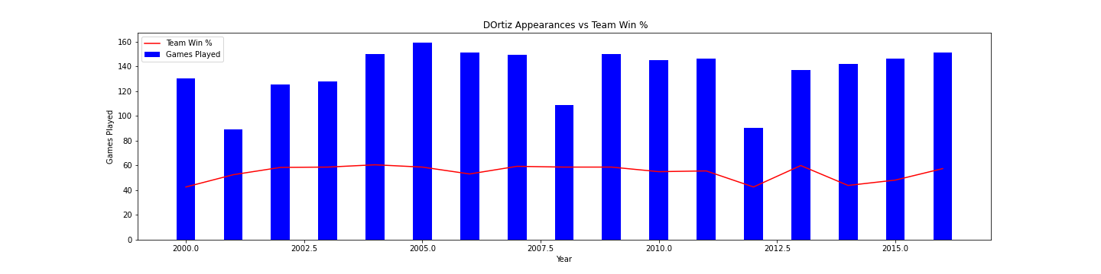
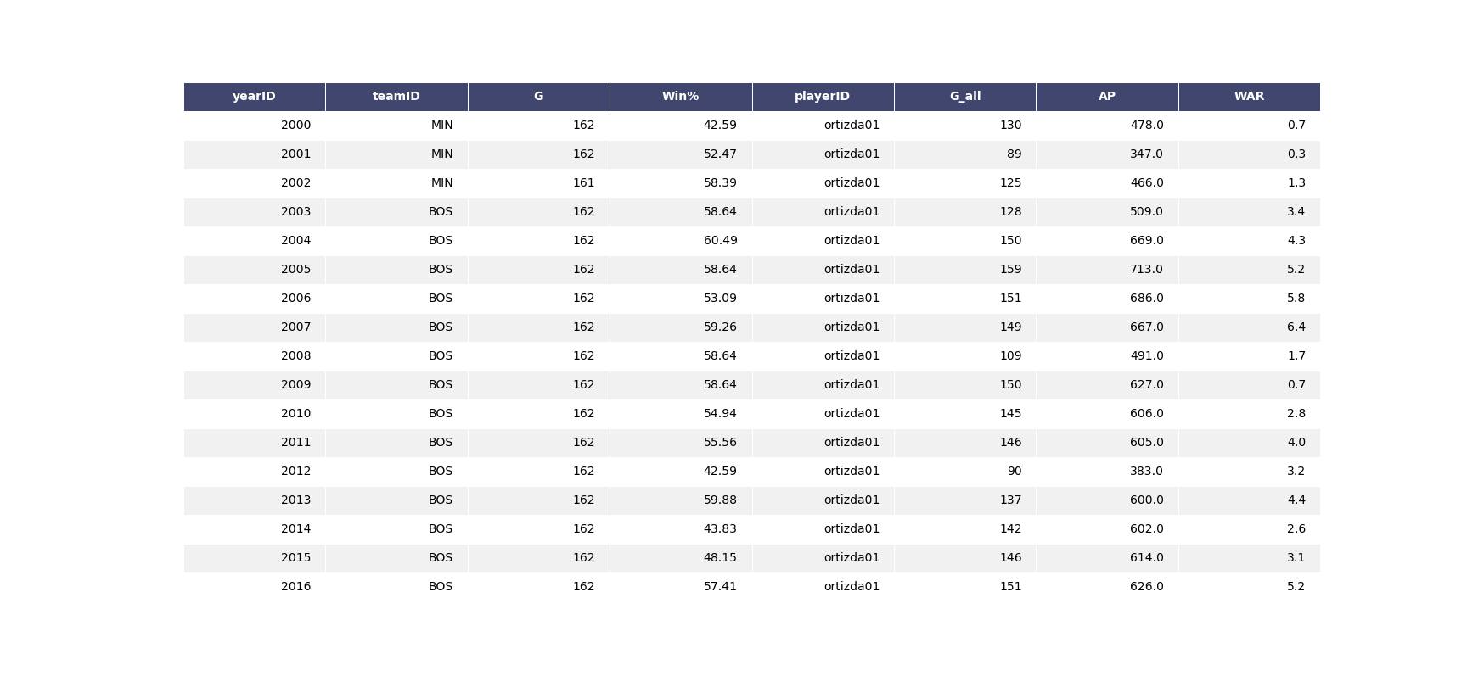

Slide 9
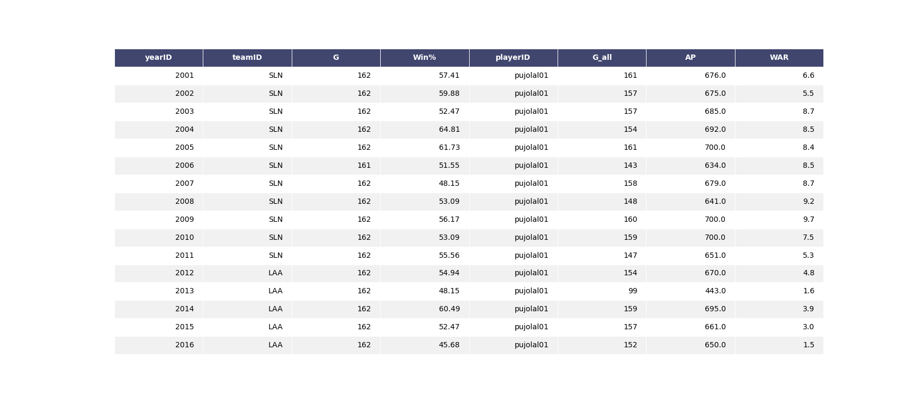
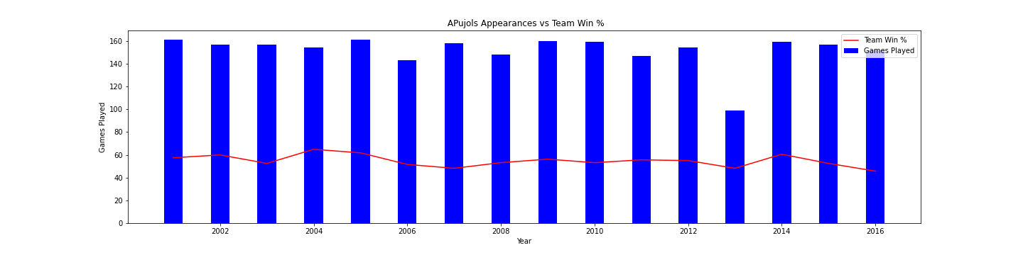

Slide 10
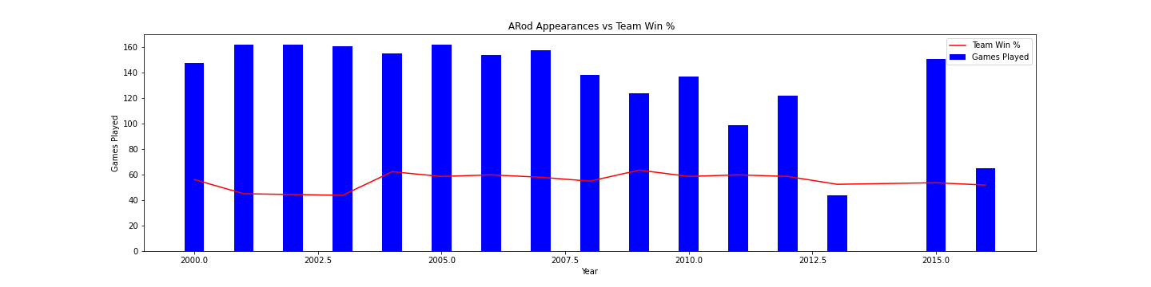


Slide 11
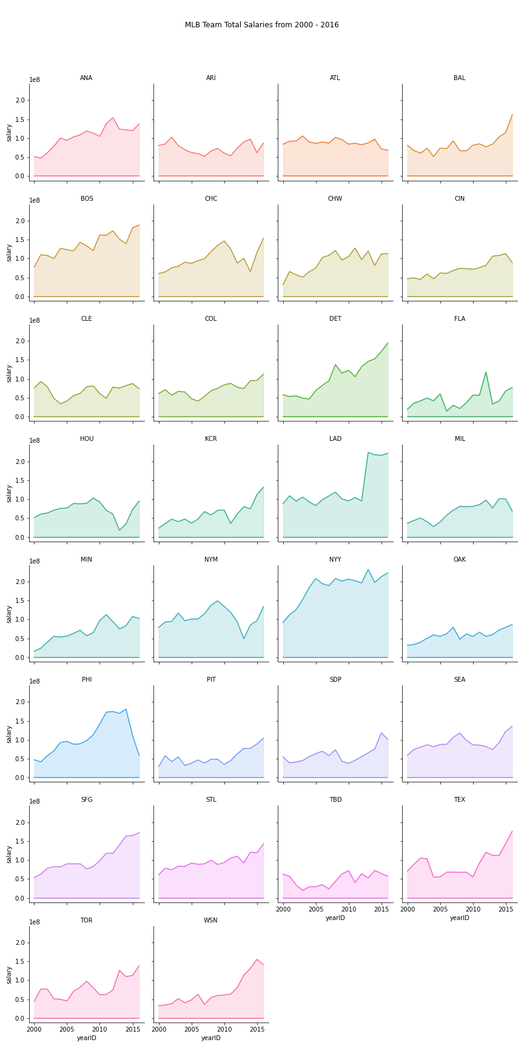

Slide 12
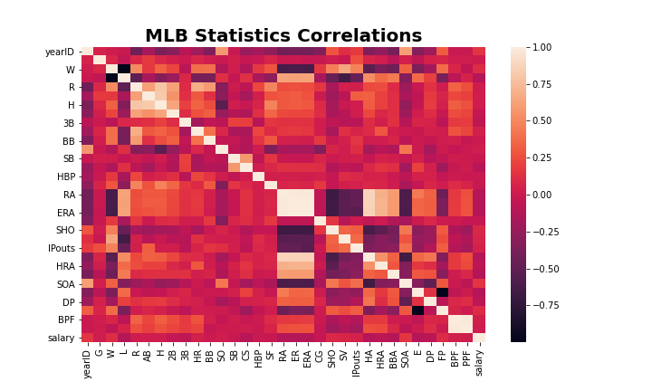
Heat Correlation

Slide 13
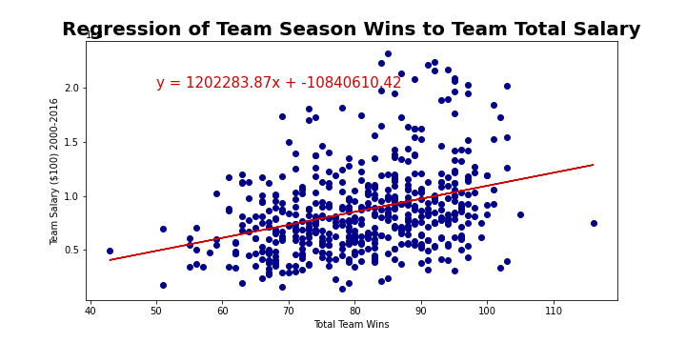
Regression

Slide 14
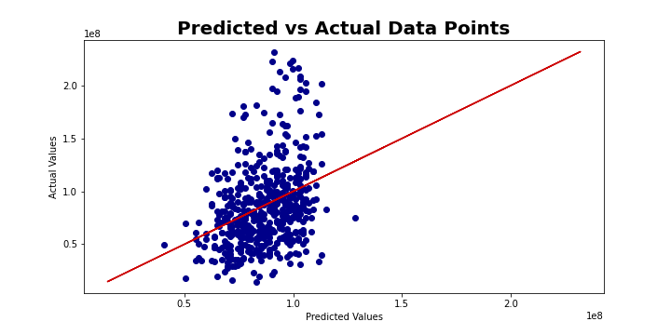
Predictions

Slide 15
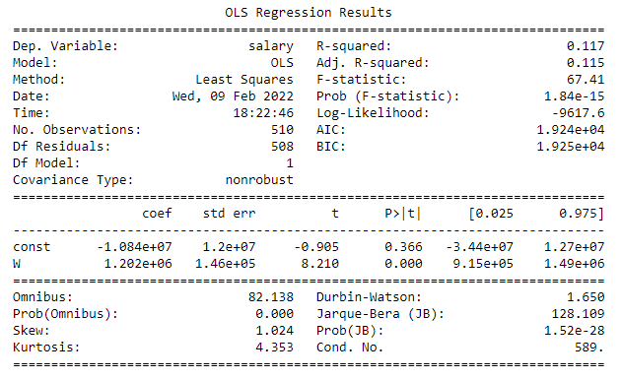
Regression Result

Slide 16
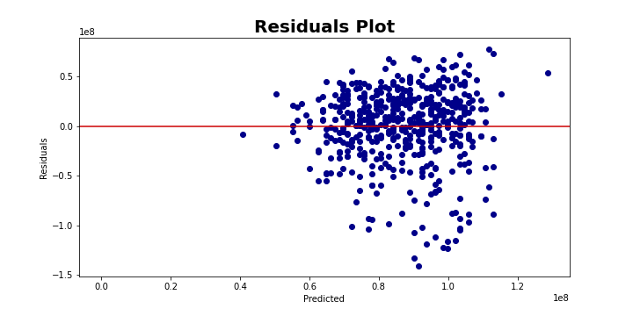
Plot

Slide 17
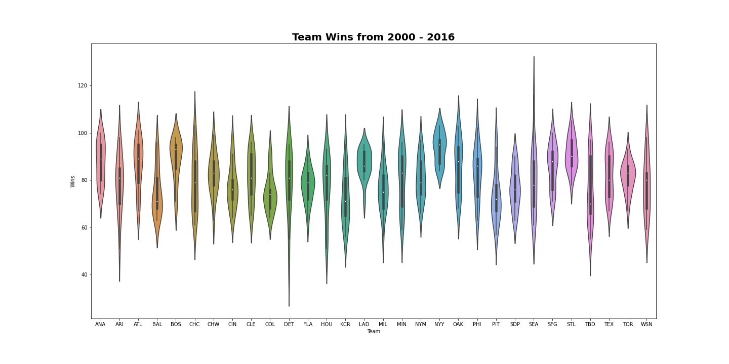
Teams Wins

Slide 18
Conclusion
Our first hypothesis was proven false.
Null hypothesis - If a team spends more on their players, then it does not guarantee higher win rate
Our hypothesis was not proved therefore we must accept the null hypothesis
Null hypothesis - If a team has a superstar player , then team win rate does not increase.

